Slide 1
Understanding customer satisfaction in the tourism industry
Prepared by:
Sarwat Zabeen

Slide 2
Trips & Travel.com wants to find out which are its most lucrative customer segments and where there is still scope for growth.
What are the underlying drivers of profitability?
Is there a scope of improvement for current sales team performance?

Slide 3

Data source
Kaggle datasets

Slide 4
T I M E L I N E S L I D E
Data Cleaning
Checking Model Assumption
Week1
Week3
Week5
Literature review
Planning the Step/ procedure
Week4
Run Model and Compare results
Week2
Using Proper Sampling Technique Exploratory Data Analysis

Slide 5
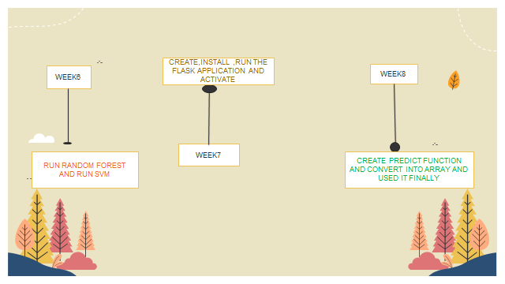

Slide 6

Techniques used
Classification problem:
Logistic regression
Decision tree
Random Forest
Naïve Bayes
SVM

Slide 7
Exploratory Data Analysis

Slide 8
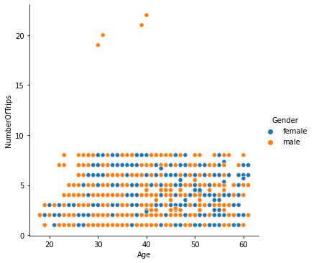
How are the variables correlated?

Slide 9
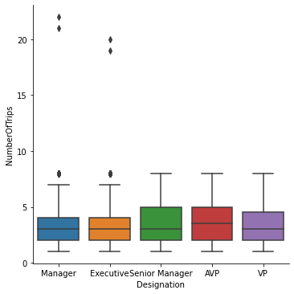
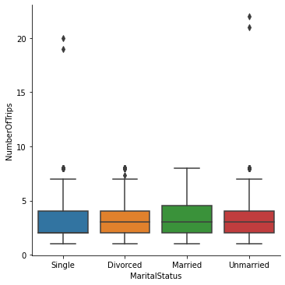
How does Designation and Marital Status afftect travel?

Slide 10
Data Cleaning
Interpolate method used to impute missing values
MinMaxScalar() of the sklearn.preprocessing library used to scale data
Quantile method used for outlier treatment

Slide 11
Machine learning techniques
Dataset was split in 80/20 ratio
Model trained on 80% and tested on the 20%
0 indicates customer is not profitable and 1 indicates profitable
Binary outcome

Slide 12
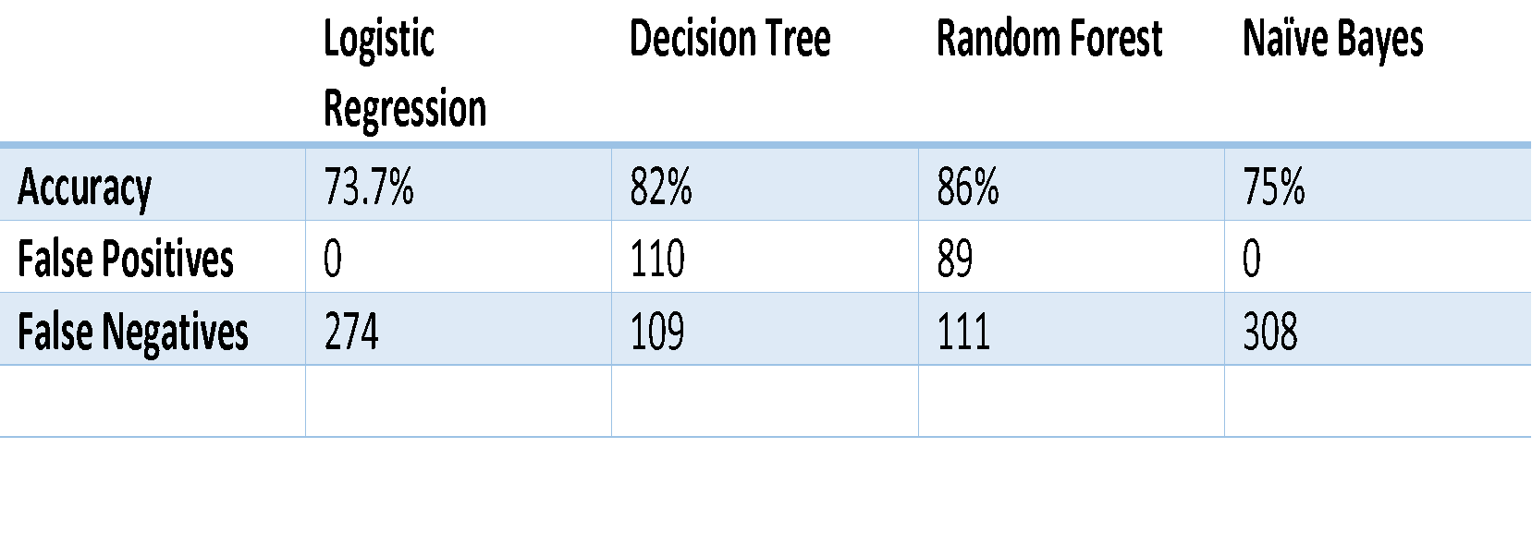
Model evaluation

Slide 13
Prediction on Test Sets
Based on the prediction on test set, accuracy and confusion matrix Random Forest was chosen as the best model

Slide 14
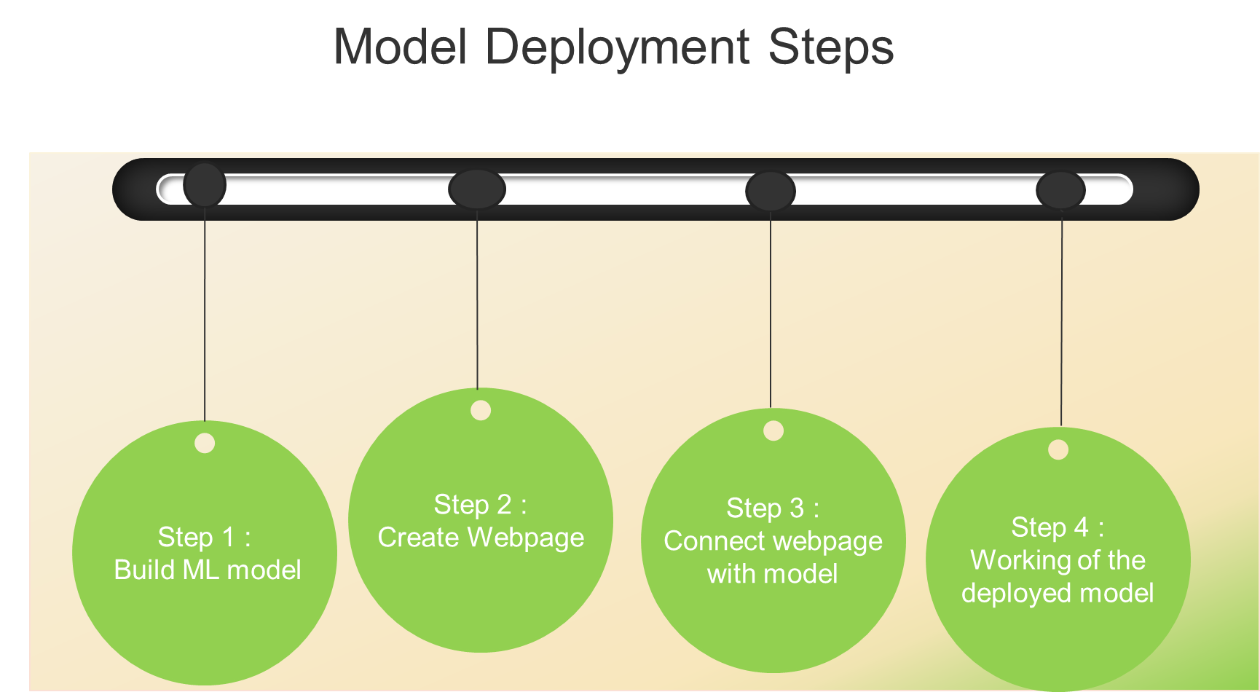

Slide 15
Live model demo using Flask
Let us see a demo

Slide 16
Limitation
Only number of trips was utilized to define profitability not total sales revenue
There were not enough responses for certain variables
Definition of “small business owner” and “Large business owner” were not available with the dataset
Accuracy for RF was 86%

